Slide 1
Electronic Medical Records & Knowledge-Based Information
Geoff Patterson (gpatter1@hfhs.org)
Regional Director of Informatics & Technology
Henry Ford Macomb Hospitals
Notes:
Patient Stories / Experiences
In 2005 live with Cerner
2007 Report - >13,000 adverse drug events (ADE) reported
- > 10% have significant, even catastrophic outcomes
- > 10% of those are fatal
= 130 lives saved within one health system alone.
Electronic Records make a difference!

Slide 2
Agenda
Why all the effort?
Electronic Health Records
Adoption Timeline
Goals / Incentives
Barriers
Knowledge Based Information
Questions

Slide 3
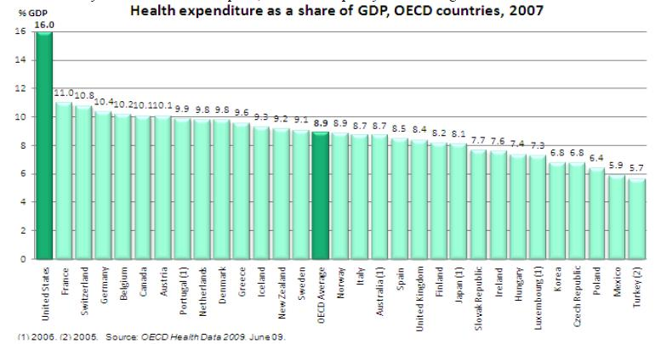
Healthcare Costs

Slide 4
Quality is the Best?
On a per capita basis also the U.S. spent the highest with a total of $7,290 which is two-and-half times the OECD average
Despite spending the most, the U.S. provides health care coverage for only the elderly, disabled and some of the poor people
  In comparison, the same amount is enough to provide universal health care insurance by the government for all citizens in other OECD countries
Life expectancy in the U.S. is lower when compared with Japan, Switzerland, Canada and Australia
Infant morality rates in the U.S. is higher than most OECD countries. In 2006, it was 6.7 per live births relative to OECD average of 4.7
The proportion of daily smokers has fallen the most (> 50%) between 1980 and 2007 in the U.S. due to public awareness and high taxation
Notes:
The public share of health care expenditure in the USA (45%) is less than any other OECD country
Obesity rate among adults is the highest in the U.S. in the OECD countries at 34.3% in 2006. Higher obesity rates leads to higher health care spending in the future

Slide 5
Dr. Don Berwick
Former head of the Center for Medicare and Medcare Services (CMS) lists six major drivers of healthcare costs:
Failure of coordination: "When handoffs don't go well, costs go up and quality goes down,"
Process failures: When you're executing a process but don't do it correctly, scientifically or reliably. One big example, Berwick said, is hospital-acquired infections.
Overtreatment: "There's a lot done in healthcare that can not possibly help the patient and I'm not talking about end-of-life care. I'm talking about you and me when we go in when we have a viral cold and we get an antibiotic," he said.
CMS's own administrative burdens: Numerous record keeping and administrative requirements and forms. CMS has launched an effort to delete many of these mandates that don't add value or quality to care.
Pricing failures: "We have very good evidence first of enormous price differences of the exact same service between here and other countries. The differences are orders of magnitude," Berwick said. He gave as examples the costs of MRI testing, and certain kinds of durable medical equipment and prosthetics.
Fraud and abuse: Berwick said some of this is linked to organized crime. Authority in the Affordable Care Act has enabled federal agencies to pre-screen suppliers and providers to assure they haven't been implicated in prior scams.

Slide 6
What is an Electronic Health Record?
Per HIMSS – “The Electronic Health Record (EHR) is a longitudinal electronic record of patient health information generated by one or more encounters in any care delivery setting. Included in this information are patient demographics, progress notes, problems, medications, vital signs, past medical history, immunizations, laboratory data and radiology reports. The EHR automates and streamlines the clinician's workflow.”

Slide 7
What is an Electronic Health Record?
Electronic Medical Record (EMR) – An electronic record of care in a given provider environment which can be stored on one or many platforms.
  Prominent in hospitals, physician offices and ancillary centers.
  Can be a single platform (Cerner, Epic) or a collection of multiple platforms (Lab, PACS, RIS, HemOnc).
  Populated with documentation and results from care delivered.
Personal Health Record – An electronic record of care across multiple environments collected via interface or personal reporting with the goal of consolidating all care for a given patient.
  Can be online, portable memory stick or paper

Slide 8
Electronic Health Record
The ultimate goal is to allow for seamless data sharing across the entire care delivery system, from hospitals to physician offices, pharmacies to durable medical equipment companies.
Examples of the benefit if this is done properly:
  Office visit notes will be immediately available in an emergency room or urgent care setting
  Your primary care physician will know immediately when you are receiving care somewhere else.
  Allergy, Medication list and previous visit information will be available immediately
  Billing will be based on actual care delivered in an automated fashion
  Disease monitoring will be data driven

Slide 9
Adoption Timeline
Electronic Health Records have been around for decades and primarily included
  Results lookup
  patient charges
  demographic information
Over the past decade, research and events have caused the adoption “curve” to sharply increase

Slide 10
Adoption Timeline
The Institute of Medicine’s “To Err is Human (2000)”
  Betsy Lehman
  Willie King
  Ben Kolb
Suggested that between 44,000 and 98,000 Americans die each as a result of medical errors.
Even when using the lower estimate, more people die in a given year as a result of medical errors than from motor vehicle accidents (43,458), breast cancer (42,297), or AIDS (16,516).
Total national costs (lost income, lost household production, disability and health care costs) of preventable adverse events (medical errors resulting in injury) are estimated to be between $17 billion and $29 billion, of which health care costs represent over one-half.
  Even with these staggering statistics – Adoption was mediocre at best (10% - 20% nationwide)
Notes:
The knowledgeable health reporter for the Boston Globe, Betsy Lehman, died from an overdose during chemotherapy.
Willie King had the wrong leg amputated.
Ben Kolb was eight years old when he died during ''minor" surgery due to a drug mix-up

Slide 11
Adoption Timeline
The American Recovery and Reinvestment Act of 2009 specifies three main components of Meaningful Use:
  The use of a certified EHR in a meaningful manner, such as e-prescribing.
  The use of certified EHR technology for electronic exchange of health information to improve quality of health care.
  The use of certified EHR technology to submit clinical quality and other measures.
    Simply put, "meaningful use" means providers need to show they're using certified EHR technology in ways that can be measured significantly in quality and in quantity.
CMS EHR Meaningful Use Criteria Summary
  The criteria for meaningful use will be staged in three steps over the course of the next five years.
  Stage 1 (2011 and 2012) sets the baseline for electronic data capture and information sharing.
  Stage 2 (expected to be implemented in 2014) and Stage 3 (expected to be implemented in 2015 or beyond…) will continue to expand on this baseline and be developed through future rule making.
*Taken from cms.gov, November, 2011

Slide 12
Goals / Incentives
Goals
  Improve quality and safety through technology and process improvements
  Decrease variations in care
  Reduce redundancy
  Decrease billing errors
  Save Money
Incentives
  Provides incentives for hospitals and physician offices to adopt certified technology
    For Providers - Up to $44,000 per provider over 5 years
    For Hospitals – based on a percentage of discharges. For most facilities – opportunity is tens of millions of dollars
  After implementation window – reimbursement will be cut for those who do not adopt.

Slide 13
Barriers
Standards, or lack of …
Examples of key healthcare integration standards include:
HL7 - Health Level Seven – provides standards for exchanging clinical data.
DICOM - Digital Imaging and Communications in Medicine – provides for handling, storing, printing, and transmitting information in medical imaging.
HL7 CDA - Clinical Document Architecture – provides an exchange model (XML-based) for clinical documents (such as discharge summaries and progress notes); recently known as the Patient Record Architecture (PRA).
CCR - Continuity of Care Record – responds to the need to organize and make transportable a set of basic information about a patient’s health care that is accessible to clinicians and patients.
CCOW - Clinical Context Management Specification – allows clinical applications to share information at the point of care.
LOINC - Logical Observation Identifiers Names and Codes – applies universal code names and identifiers to medical terminology related to the Electronic Health Record and assists in the electronic exchange and gathering of clinical results (such as laboratory tests, clinical observations, outcomes management and research).
ELINCS - EHR-Lab Interoperability and Connectivity Standards – an emerging standard for reporting lab test results.
X12 - Provides for electronic exchange of business transactions-electronic data interchange (EDI). The American National Standards Institute (ANSI) chartered the Accredited Standards Committee (ASC) X12 to develop uniform standards.
SNOMED - Systematized Nomenclature of Medicine Clinical Terms – provides comprehensive computerized clinical terminology covering clinical data for diseases, clinical findings, and procedures.
NCPDP - National Council for Prescription Drug Programs – governs prescription transactions.
IHE - Integrating the Healthcare Enterprise – promotes the coordinated use of established healthcare integration standards, such as DICOM and HL7, to address specific clinical needs in support of optimal patient care.
CCHIT - Certification Commission for Healthcare Information Technology – serves as the recognized US certification authority for electronic health records (EHR) and their networks. In September 2005, CCHIT was awarded a 3-year contract by the U.S. Department of Health and Human Services to develop and evaluate the certification criteria and inspection process for EHRs and the networks through which they interoperate.
HITSP - Healthcare Information Technology Standards Panel – assists in achieving widely accepted and readily-implemented consensus-based standards that will enable and support widespread interoperability among healthcare information technology, especially as they would interact in a Nationwide Health Information Network (NHIN) for the United States.

Slide 14
Barriers
Resistance to change (beliefs)
  Physicians are paid based on time and efficiency. Direct documentation takes time and effort – making them less productive.
  Less time is spent with the patient as clinicians
  “stare at the screen”.
  Computer programs are never “bug free”.

Slide 15
Barriers
Incentives, really?
  $44,000 per physician may not be enough to offset the operational inefficiencies, reduced billing, hardware and system implementation fees required to adopt technology.
  While facilities are eligible for tens of millions in reimbursement, system (hardware, software and implementation) costs are usually in the hundreds of millions.
  Risk of losing physicians and staff as a result of burnout.

Slide 16
Barriers
Competing Priorities
  ICD 10
  Accountable Care Organizations (ACO)
  Growth and Market Demographic changes
  Reimbursement decreases
  OTHER Governmental Mandates
    Decrease length of stay
    Readmissions
    Quality (No Harm, etc).
  Taking care of patients

Slide 17
Barriers
Cooperation
Electronic documentation changes clinician practice patterns
Electronic documentation requires structure that otherwise is not mandatory
Not everyone is comfortable with technology
Change is difficult
Data Exchange Standards
As mentioned dozens of standard data formats exist and are in use.
  Ensuring like systems use like standards is difficult
“Sure we’ll adopt a standard - as long as it’s ours”
No formal regulatory body has oversight
* Will be driven by the government via the HIE mandate

Slide 18
Barriers
Security
Move over HIPAA – HITECH is here
Healthcare is a large attack base
Medical identity theft is very lucrative
Regulations are overwhelming
Cost
A fully integrated suite of applications for a medium sided health system (St. John, Henry Ford, Beaumont, etc.) will be hundreds of millions to install
Post installation support (staff, maintenance costs, etc) are significant
You are never truly done implementing – EMR’s are living, breathing animals.

Slide 19
Knowledge Based Information
Evidenced based care often based on personal experience, not evidence
Providing real time information for decision making is vital
  Must be easy to access (think Google)
  Must be timely
  Must be consistent
Integrated, single sign on access
  Embed knowledge sources in an overall “portal” with the EMR
Large gap between need and availability

Slide 20
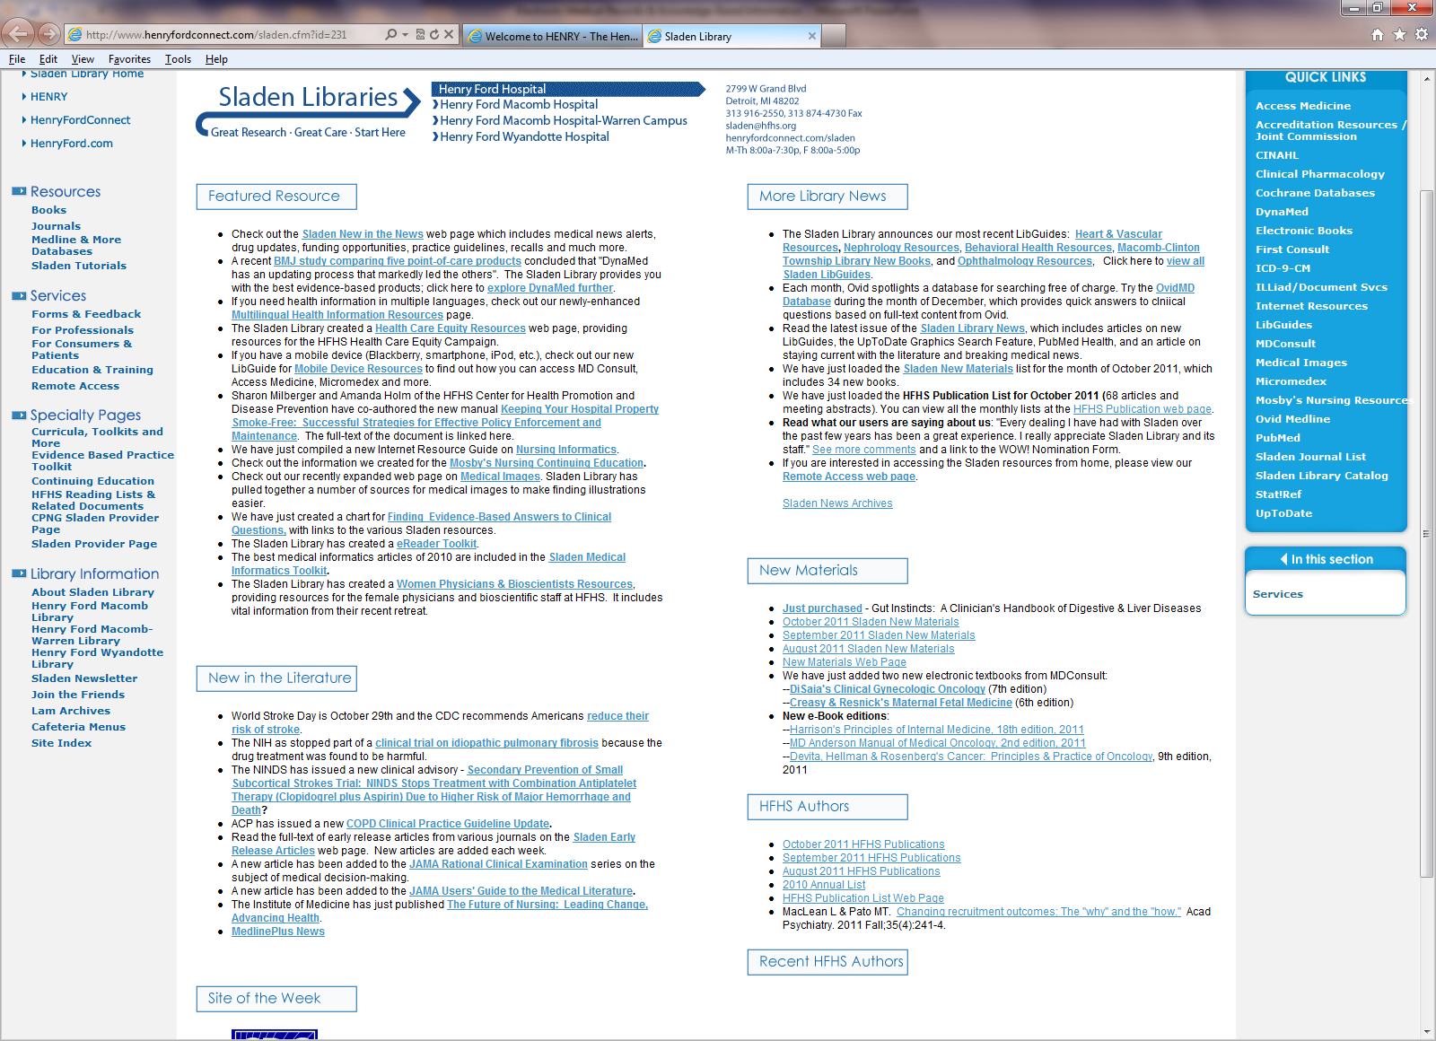
Sladen Library

Slide 21
What does the Future Hold?
Integration of resources
  Data seamlessly integrated across the entire continuum of care
  Availability is almost immediate
Mobility
  Integration with smart devices (iPads, Tablets, Smart Phones) is the current direction
  Seamless care – even when off campus
Integrated information
  Appropriate popup messages linking to evidenced based references
  Suggested care interventions based on existing data
  Predictive modeling for disease, age and demographics

Slide 22

Questions

